Slide 1
Predictive task
Prepare predictive model(s) of default. Default client is defined as one with loan_status variable taking on the following levels:
Charged off
Default
Does not meet the credit policy. Status: Charged Off
Late (31-120 days)
prepared by:
Vladyslav Lisnyi

Slide 2
CONTENT
Case study description
Dataset and features
Feature selection
Classifiers:
Logistic Regression
Random Forest
SVM
Gradient Boosting
MLPC
XGBoost
Model(s) improvement and validation
Interpretation of results

Slide 3
CASE STUDY
Prepare predictive model(s) of default. Default client is defined as one with loan_status variable taking on the following levels:
Charged off
Default
Does not meet the credit policy. Status: Charged Off
Late (31-120 days)
Model purpose:
The model is aimed at identification of ‘default’ clients early on the stage of application process, by independently accessing a risk level and a creditworthiness of the potential borrower.

Slide 4
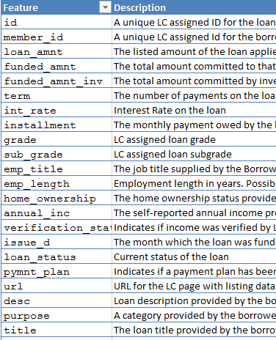

DATASET AND FEATURES
The dataset consist of 145 variables:
83 numerical variables
18 categorical variables
11 date variables
3 text variables
+ 30 variables (+95% of missing data)
1M+ loan records
Each record contains data regarding loan details, borrower financial and credit history, and list of variables that specifies certain time frames (ex. time since first credit record)

Slide 5
FEATURE SELECTION
Numerical: drop variables with 90% of zeros
Numerical: remove highly correlated variable (+95%)
PCA used for model improvement.
Categorical: get dummies
Initial dataset
Remove columns that missing 70% of values.
Create 4 subframes based on data type
Final dataset
Datetime: create (float) 'since_ecl' and 'tto_last_p'
Logical Selection
Text: NLP (vectorization)
Notes:
28: id, member_id, url, orig_projected_additional_accrued_interest, hardship_dpd, deferral_term, hardship_amount, hardship_length, hardship_last_payment_amount, hardship_payoff_balance_amount, settlement_percentage, settlement_term, settlement_amount, sec_app_mths_since_last_major_derog, sec_app_revol_util, sec_app_open_act_il, sec_app_num_rev_accts, revol_bal_joint, sec_app_inq_last_6mths, sec_app_mort_acc, sec_app_open_acc, sec_app_collections_12_mths_ex_med, sec_app_chargeoff_within_12_mths, annual_inc_joint, dti_joint, mths_since_last_record, mths_since_recent_bc_dlq, mths_since_last_major_derog

Slide 6
FEATURE SELECTION
Final dataset
Final dataset consist of 71 features:
67 numerical scaled characteristics, including 2 columns calculated from dates subframe:
‘since_ecl’ = difference (days) between todays date and ‘earliest_cr_line’
‘tto_last_pmnt’ = difference (days) between 'last_credit_pull_d‘ and 'last_pymnt_d'
3 categorical features: ‘grade’, ‘purpose’ and ‘verification_status’
3 text variables: each used separately for NLP + PCA
Model improvement
Initial testing

Slide 7
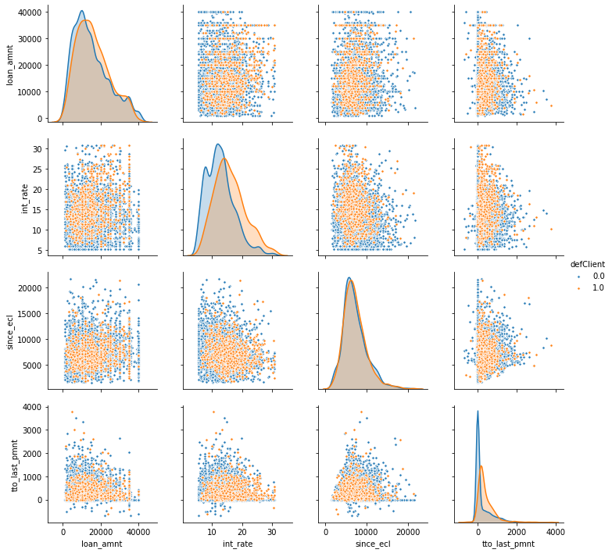
As it visible on the graph new variables ‘since_ecl’ and ‘tto_last_pmnt’ provides additional information regarding two classes.
FEATURE SELECTION

Slide 8
CLASSIFIERS
Initial Testing
LogisticRegression
Model Improvement
SVC (diff C & gamma)
MLPClassifier
RandomForestClassifier
SVC
GradientBoostingClassifier
MLPClassifier
XGBoost
XGBoost
Final Model:
XGBoost

Slide 9
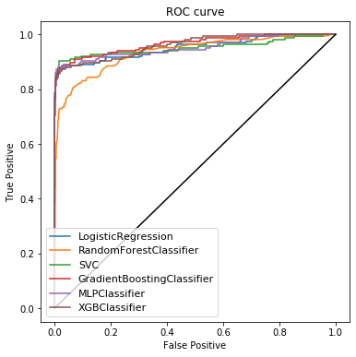
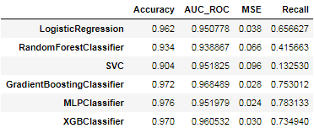
CLASSIFIERS (Metrics)
Models selected for improvement:
MLPClassifier
XGBClassifier
SVC (+GridSearchCV)

Slide 10
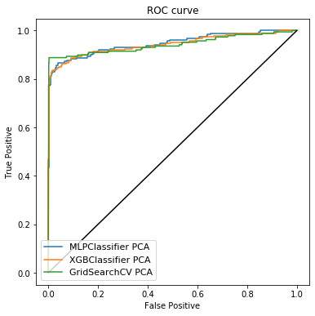

MODEL IMPROVEMENT AND VALIDATION
Use of PCA allowed to decrees number variables, but also, look at metrics above. We lost a bit in model accuracy but received a higher recall values, what means model(s) now is better at identifying between two classes.

Slide 11
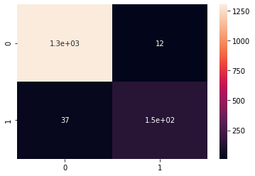
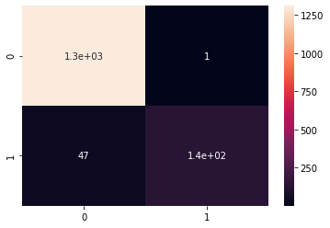

MODEL IMPROVEMENT AND VALIDATION
MLPClassifier
MLPClassifier
SVM Classifier
SVM Classifier
XGBClassifier
Consider all ROC for all three models they seemed to perform on the same level, however we can see difference in prediction of false negative. Lets try to improve our model(s) by use of NLP.

Slide 12
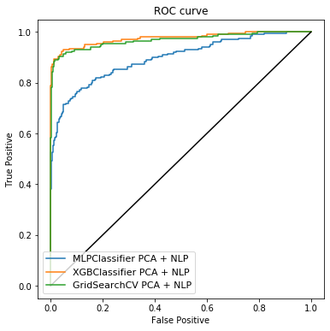

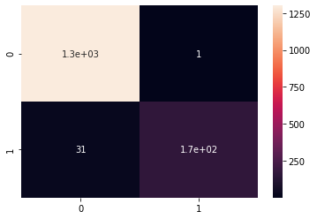
MODEL IMPROVEMENT AND VALIDATION
As we can XGBoost performs well after adding NLP. Both accuracy and recall get improved. Number of false positive is the smalles.
XGBClassifier

Slide 13
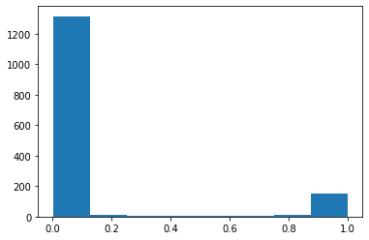
RESULTS
XGBClassifier
Cross validation score: 0.9748
Distribution of predicted probabilities
As already mentioned XGBClassifier showed the best results across tested models. The cross-validation confirmed the model score.
Change of the threshold may potentially improve prediction of the default client.
Overall, the obtained model would allow to correctly classify class 0 and 1 with confidence of 98% and predict the true default client (positive instances) in 84% of cases.

Slide 14
THANK YOU!

